Slide 1
Graphs and Trees
Basic Terminology

Slide 2
Graph
A graph G = (V ,E) consists of V , a nonempty set of vertices (or nodes) and E, a set of edges. Each edge has either one or two vertices associated with it, called its endpoints.
An edge is said to connect its endpoints.
A graph with an infinite vertex set or an infinite number of edges is called an infinite graph,
a graph with a finite vertex set and a finite edge set is called a finite graph

Slide 3
Types of Graphs
Directed Graph (Diagraph)
Undirected Graph
Weighted Graphs

Slide 4
Undirected Graph
Null graph
Simple Graph
Complete Graph
Cyclic Graph
Wheel Graph
Bipartite Graph

Slide 5
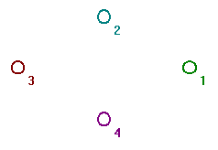
Null Graph-
A graph which contains only isolated node is called a null graph i.e. set of edges in a null graph is empty.
Null graph is denoted on 'n' vertices by N_{n.}

Slide 6
Simple graph
A graph which has neither loops nor multiple edges i.e. where each edge connects two distinct vertices and no two edges connects the same pair of vertices is called a simple graph.

Slide 7
Multigraph & Psuedograph
Any graph which contains some multiple edges is called a multigraph. In a multigraph, no loops are allowed.
A graph in which loops and multiple edges are allowed is called psuedograph.

Slide 8
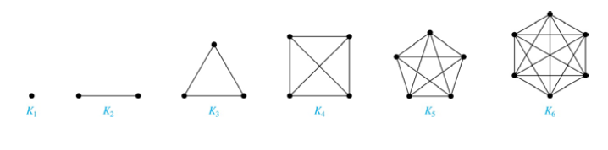
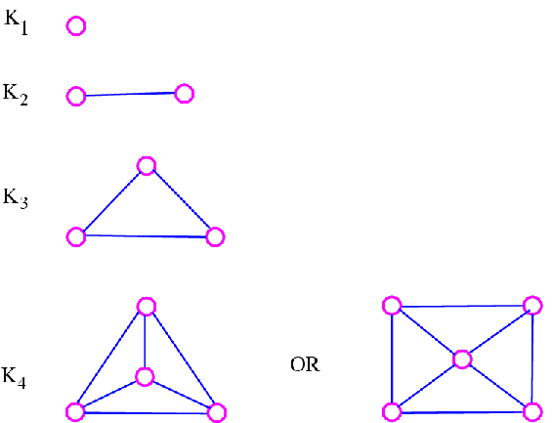
Complete Graph
A simple graph G is said to be complete if every vertex in G is connected with every other vertex i.e. if G contains exactly one edge between each pair of distinct vertices. Complete graph is denoted on 'n' vertices bt K_{n.} K_{n} has exactly n(n-1) /2 edges.

Slide 9
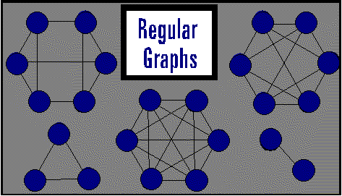
Regular Graph
A graph in which all the vertices are of equal degree is called a regular graph. If the degree of each vertex is r, then the graph is called a regular graph of degree r.
Every null graph is a regular graph of degree zero and a complete graph Kn is a regular graph of degree n-1.

Slide 10
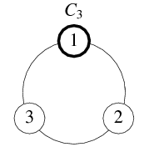
Cyclic Graph-
A graph with continuous sequence of vertices and edges is called a cyclic graph.
Cyclic graph is denoted on 'n' vertices bt C_{n where n >=3}

Slide 11
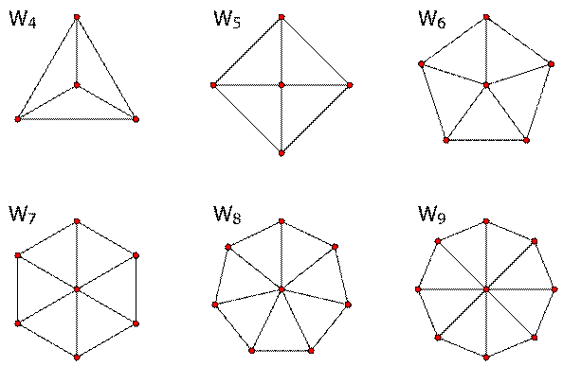
_{Wheel Graph}
A graph formed by adding a vertex inside a cycle and connecting it to every other vertex is known as wheel graph.
Wheel graph is denoted on 'n' vertices bt W_{n where n>=3.}

Slide 12

Bipartite Graph-
A graph G=(V,E) is a bipartite if the vertex set V can be partitioned into two subsets V1 and V2 such that every edge in E connects a vertex in V1 and a vertex in V2 ( no edge in G connects either two vertices in V1 or two vertices in V2) is called a bipartite graph. A bipartite graph can have no loop.

Slide 13
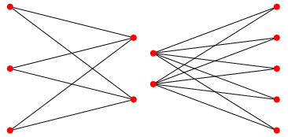
_{Complete Bipartite Graph}
A graph where a set of vertices of a graph can be partitioned into two subesets in such a way that no pair of vertices in the same set are adjacent to each other and every vertex of first set is adjacent to the _{second set.}

Slide 14
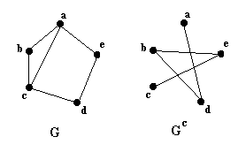
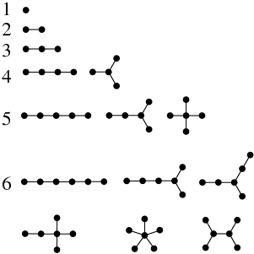
Concepts of Graph
Complement of a graph is a graph will same number of vertices with the property that if edges are present in the original graph there wont be any edge in the complement and vice versa. A graph and its complement together would give a complete graph.
Order of a Graph- Order of a graph is defined as the number of vertices present in the graph.

Slide 15
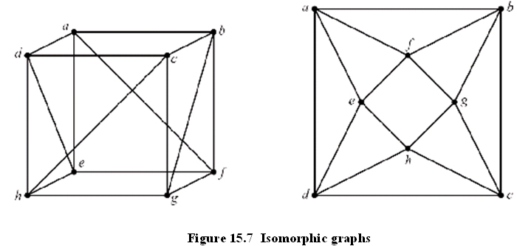
Isomorphism of Graphs
Two graphs are said to be isomorphic if there exists a bijective function from the set of vertices of the first graph to the set of vertices of the second graph in such a way that the adjacency relation (if 2 vertices are adjacent, then their images are also adjacent) is maintained.

Slide 16
Handshaking Theorem
Handshaking theorem states that the sum of degrees of the vertices of a graph is twice the number of edges.If G=(V,E) be a graph with E edges,then- Σ deg_{G}(V) = 2E
Proof-
Since the degree of a vertex is the number of edges incident with that vertex, the sum of degree counts the total number of times an edge is incident with a vertex. Since every edge is incident with exactly two vertices,each edge gets counted twice,once at each end. Thus the sum of the degrees is equal twice the number of edges.
-> This theorem applies even if multiple edges and loops are present. The theorem holds this rule that if several people shake hands, the total number of hands shake must be even that is why the theorem is called handshaking theorem.
Corollary: In a graph, the total number of odd degree vertices is even.

Slide 17
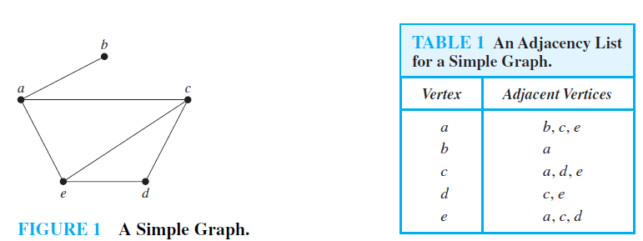
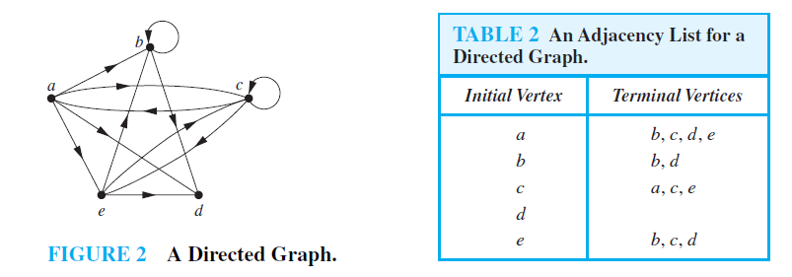
Some Representations for Graph

Slide 18
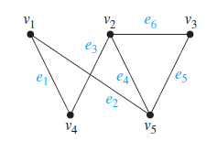
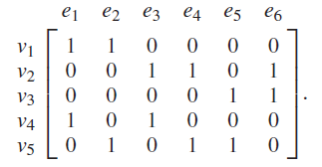
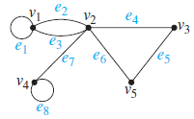
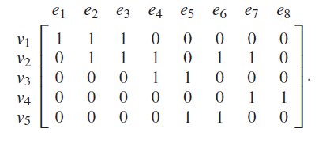
Adjacency Matrices
Incidence matrices
Represent the incidence matrix for given graph.
Incidence Matrix

Slide 19
Isomorphism of Graph
The simple graphs G1 = (V1,E1) and G2 = (V2,E2) are isomorphic if there exists a oneto-one and onto function f from V1 to V2 with the property that a and b are adjacent in G1 if and only if f (a) and f (b) are adjacent inG2, for all a and b in V1. Such a function f is called an isomorphism.Two simple graphs that are not isomorphic are called nonisomorphic.

Slide 20
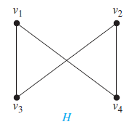
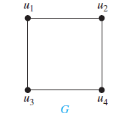
Show that the graphs G = (V ,E) and H = (W, F), displayed in Figure 8, are isomorphic.
The function f with f (u1) = v1, f (u2) = v4, f (u3) = v3, and f (u4) = v2 is a oneto- one correspondence between V and W. To see that this correspondence preserves adjacency,
note that adjacent vertices in G are u1 and u2, u1 and u3, u2 and u4, and u3 and u4, and each of the
pairs f (u1) = v1 and f (u2) = v4, f (u1) = v1 and f (u3) = v3, f (u2) = v4 and f (u4) = v2, and f (u3) = v3 and f (u4) = v2 consists of two adjacent vertices in H.

Slide 21
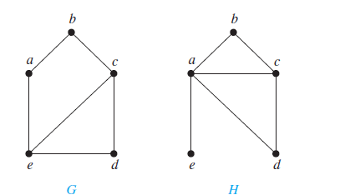
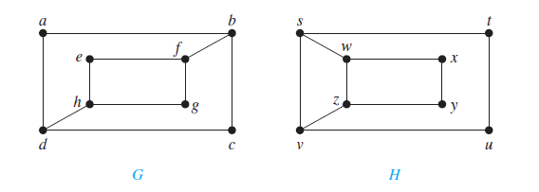
Determine wheather the graphs are isomorphic or not
Not Isomorphic
Isomorphic

Slide 22
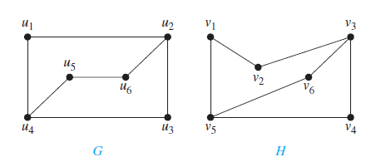
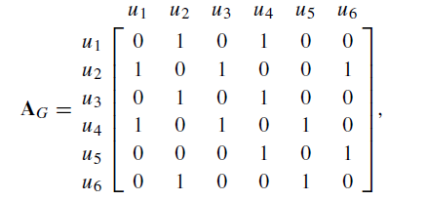
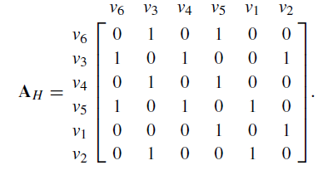
Both G and H have six vertices and seven edges. Both have four vertices of degree two and two vertices of degree three.
arbitrarily set f (u1) = v6. [If we found that this choice did not lead to isomorphism, we would then try f (u1) = v4.]. We arbitrarily set f (u2) = v3. Continuing in this way, we set f (u3) = v4, f (u4) = v5, f (u5) = v1, and f (u6) = v2.We now have a one-to-one correspondence between the vertex set of G and the vertex set of H, namely, f (u1) = v6, f (u2) = v3, f (u3) = v4, f (u4) = v5, f (u5) = v1, f (u6) = v2.

Slide 23
Connectivity
Paths- is a sequence of edges that begins at a vertex of a graph and travels from vertex to vertex along edges of the graph.
Formal Definition
A path of length n from u to v in G is a sequence of n edges e1, . . . , en of G for which there exists a sequence x0 = u, x1, . . . , xn−1, xn = v of vertices such that ei has, for i = 1, . . . , n, the endpoints xi−1 and xi . When the graph is simple, we denote this path by its vertex sequence x0, x1, . . . , xn (because listing these vertices uniquely determines the path).
The path is a circuit if it begins and ends at the same vertex, that is, if u = v, and has length greater than zero. The path or circuit is said to pass through the vertices x1, x2, . . . , xn−1 or traverse the edges e1, e2, . . . , en. A path or circuit is simple if it does not contain the same edge more than once.

Slide 24
cut vertices (or articulation points): Sometimes the removal of a vertex from a graph and all incident edges produces a subgraph with more connected components. Such vertices are called cut vertices (or articulation points).
The removal of a cut vertex from a connected graph produces a subgraph that is not connected.
cut edge or bridge: an edge whose removal produces a graph with more connected components than in the original graph is called a cut edge or bridge.
Ex. in a graph representing a computer network, a cut vertex and a cut edge represent an essential router and an essential link that cannot fail for all computers to be able to communicate.

Slide 25
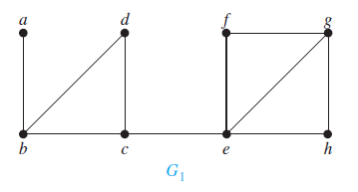
Find the cut vertices and cut edges in the graph G1 shown in Figure
The cut vertices of G1 are b, c, and e. The removal of one of these vertices (and its adjacent edges) disconnects the graph.
The cut edges are {a, b} and {c, e}. Removing either one of these edges disconnects G1.
Not all graphs have cut vertices. For example, the complete graph Kn, where n ≥ 3, has no cut vertices. When you remove a vertex from Kn and all edges incident to it, the resulting subgraph is the complete graph Kn−1, a connected graph. Connected graphs without cut vertices are called nonseparable graphs,

Slide 26
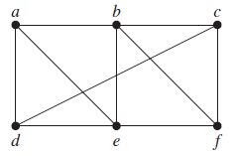
A subset V of the vertex set V of G = (V ,E) is a vertex cut, or separating set, if G − V’ is disconnected.
the set {b, c, e} is a vertex cut with three vertices,

Slide 27
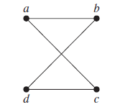
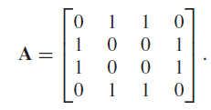
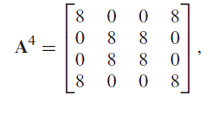
Counting paths in between two vertices
How many paths of length four are there from a to d in the simple graph G
Hence, the number of paths of length four from a to d is the (1, 4)th entry of A4.
there are exactly eight paths of length four from a to d. By inspection of the graph, we see that a, b, a, b, d; a, b, a, c, d; a, b, d, b, d; a, b, d, c, d; a, c, a, b, d; a, c, a, c, d; a, c, d, b, d; and a, c, d, c, d are the eight paths of length four from a to d.

Slide 28
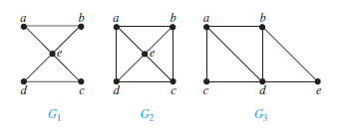
Euler path and Euler Circuit
An Euler circuit in a graph G is a simple circuit containing every edge of G. An Euler path in G is a simple path containing every edge of G.
The graph G1 has an Euler circuit, for example, a, e, c, d, e, b, a. Neither of the graphs G2 or G3 has an Euler circuit. However, G3 has an Euler path, namely, a, c, d, e, b, d, a, b. G2 does not have an Euler path

Slide 29
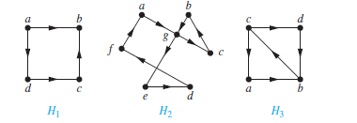
Which of the directed graphs in Figure 4 have an Euler circuit? Of those that do not, which have an Euler path?
The graph H2 has an Euler circuit, for example, a, g, c, b, g, e, d, f, a. Neither H1 nor H3 has an Euler circuit.H3 has an Euler path, namely, c, a, b, c, d, b, but H1 does not.
A connected multigraph with at least two vertices has an Euler circuit if and only if each of its vertices has even degree.

Slide 30
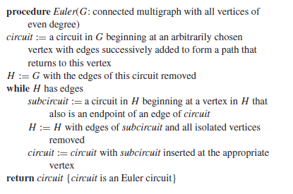
Algorithm to construct Euler Circuit

Slide 31
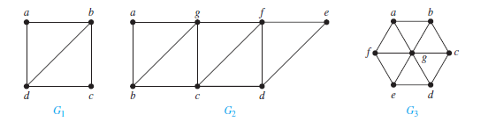
A connected multigraph has an Euler path but not an Euler circuit if and only if it has exactly two vertices of odd degree.
G1 contains exactly two vertices of odd degree, namely, b and d. One such Euler path is d, a, b, c, d, b.
Similarly,G2 has exactly two vertices of odd degree, namely, b and d. So it has an Euler path that must have
b and d as endpoints. One such Euler path is b, a, g, f, e, d, c, g, b, c, f, d.
G3 has no Euler path because it has six vertices of odd degree.

Slide 32
Hamilton Paths and Circuits
A simple path in a graph G that passes through every vertex exactly once is called a Hamilton path, and a simple circuit in a graph G that passes through every vertex exactly once is called a Hamilton circuit.
That is, the simple path x0, x1, . . . , xn−1, xn in the graph G = (V ,E) is a Hamilton path if V = {x0, x1, . . . , xn−1, xn} and xi = xj for 0 ≤ i < j ≤ n, and the simple circuit x0, x1, . . . , xn−1, xn, x0 (with n > 0) is a Hamilton circuit if x0, x1, . . . , xn−1, xn is a Hamilton path.

Slide 33
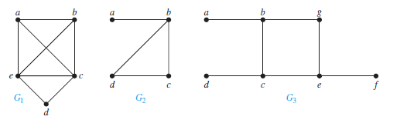
G1 has a Hamilton circuit: a, b, c, d, e, a. There is no Hamilton circuit in G2 (this can be seen by noting that any circuit containing every vertex must contain the edge {a, b} twice),
but G2 does have a Hamilton path, namely, a, b, c, d. G3 has neither a Hamilton circuit nor a Hamilton path, because any path containing all vertices must contain one of the edges {a, b}, {e, f }, and {c, d} more than once.

Slide 34
A complete graph Kn has a Hamilton circuit whenever n ≥ 3.
If G is a simple graph with n vertices with n ≥ 3 such that the degree of every vertex in G is at least n/2, then G has a Hamilton circuit.
If G is a simple graph with n vertices with n ≥ 3 such that deg(u) + deg(v) ≥ n for every pair of nonadjacent vertices u and v in G, then G has a Hamilton circuit.

Slide 35
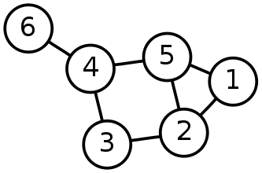
Single-Source Shortest Path Problem
Single-Source Shortest Path Problem - The problem of finding shortest paths from a source vertex v to all other vertices in the graph.

Slide 36
Dijkstra's algorithm
Dijkstra's algorithm - is a solution to the single-source shortest path problem in graph theory.
Works on both directed and undirected graphs. However, all edges must have nonnegative weights.
Input: Weighted graph G={E,V} and source vertex v∈V, such that all edge weights are nonnegative
Output: Lengths of shortest paths (or the shortest paths themselves) from a given source vertex v∈V to all other vertices

Slide 37
Approach
The algorithm computes for each vertex u the distance to u from the start vertex v, that is, the weight of a shortest path between v and u.
the algorithm keeps track of the set of vertices for which the distance has been computed, called the cloud C
Every vertex has a label D associated with it. For any vertex u, D[u] stores an approximation of the distance between v and u. The algorithm will update a D[u] value when it finds a shorter path from v to u.
When a vertex u is added to the cloud, its label D[u] is equal to the actual (final) distance between the starting vertex v and vertex u.

Slide 38
Example: Initialization
Distance(source) = 0
0
∞
Distance (all vertices but source) = ∞
A
2
B
4
1
3
10
∞
C
2
D
2
E
∞
5
8
∞
4
6
F
1
G
∞
∞
Pick vertex in List with minimum distance.

Slide 39
Example: Update neighbors' distance
0
2
A
2
B
4
1
3
10
∞
C
2
D
2
E
∞
5
8
1
4
6
Distance(B) = 2
F
1
G
Distance(D) = 1
∞
∞

Slide 40
Example: Remove vertex with minimum distance
0
2
A
2
B
4
1
3
10
∞
C
2
D
2
E
∞
5
8
1
4
6
F
1
G
∞
∞
Pick vertex in List with minimum distance, i.e., D

Slide 41
Example: Update neighbors
0
2
A
2
B
4
1
3
10
3
C
2
D
2
E
3
5
8
1
4
6
Distance(C) = 1 + 2 = 3 Distance(E) = 1 + 2 = 3 Distance(F) = 1 + 8 = 9 Distance(G) = 1 + 4 = 5
F
1
G
9
5

Slide 42
Example: Continued...
Pick vertex in List with minimum distance (B) and update neighbors
0
2
A
2
B
4
1
3
10
3
C
2
D
2
E
3
5
8
1
4
6
Note : distance(D) not updated since D is already known and distance(E) not updated since it is larger than previously computed
F
1
G
9
5

Slide 43
Example: Continued...
Pick vertex List with minimum distance (E) and update neighbors
0
2
A
2
B
4
1
3
10
3
C
2
D
2
E
3
5
8
1
4
6
F
1
G
No updating
9
5

Slide 44
Example: Continued...
Pick vertex List with minimum distance (C) and update neighbors
0
2
A
2
B
4
1
3
10
3
C
2
D
2
E
3
5
8
1
4
6
Distance(F) = 3 + 5 = 8
F
1
G
8
5

Slide 45
Example: Continued...
Pick vertex List with minimum distance (G) and update neighbors
0
2
A
2
B
4
1
3
10
3
C
2
D
2
E
3
5
8
1
4
6
F
1
G
Previous distance
6
5
Distance(F) = min (8, 5+1) = 6

Slide 46
Example (end)
0
2
A
2
B
4
1
3
10
3
C
2
D
2
E
3
5
8
1
4
6
F
1
G
6
5
Pick vertex not in S with lowest cost (F) and update neighbors

Slide 47
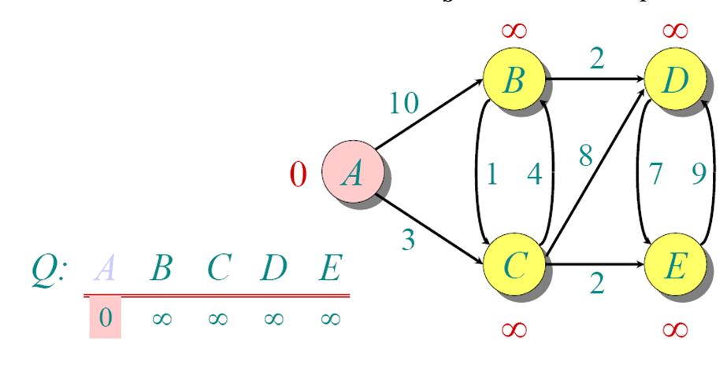
Another Example

Slide 48
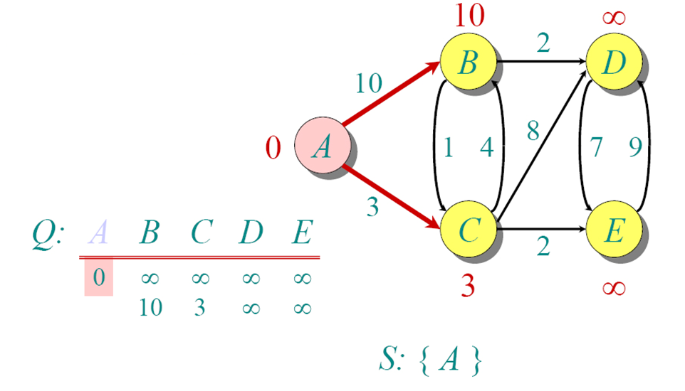
Another Example

Slide 49
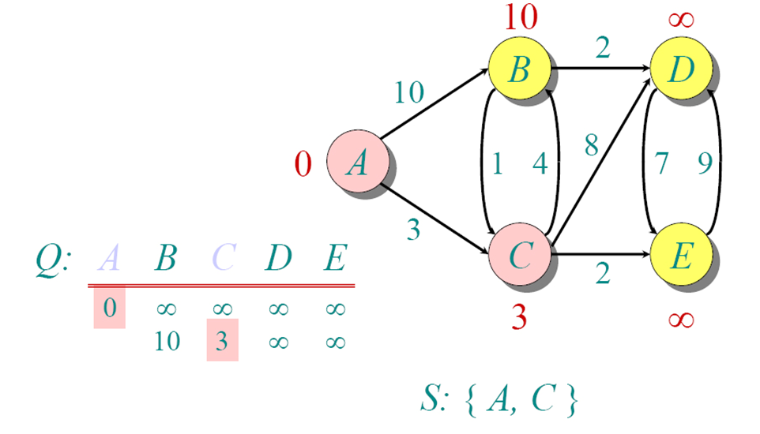
Another Example

Slide 50
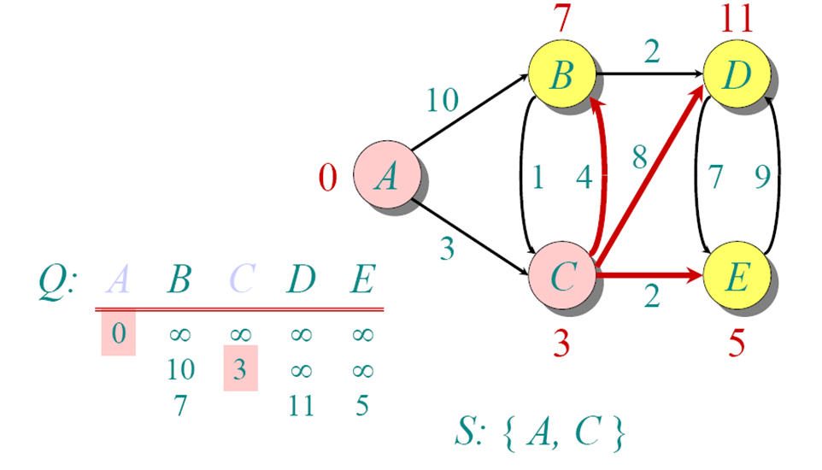
Another Example

Slide 51
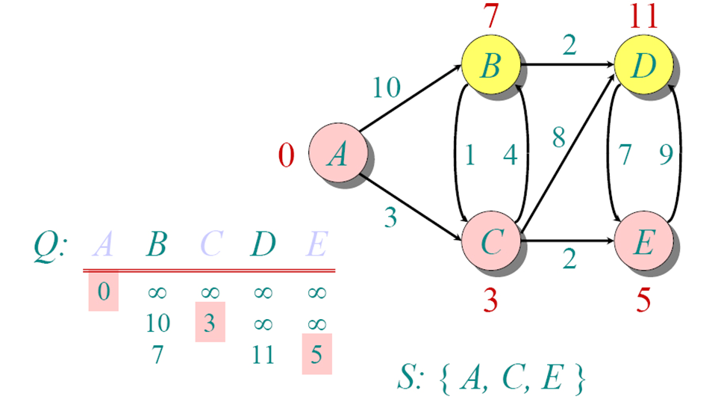
Another Example

Slide 52
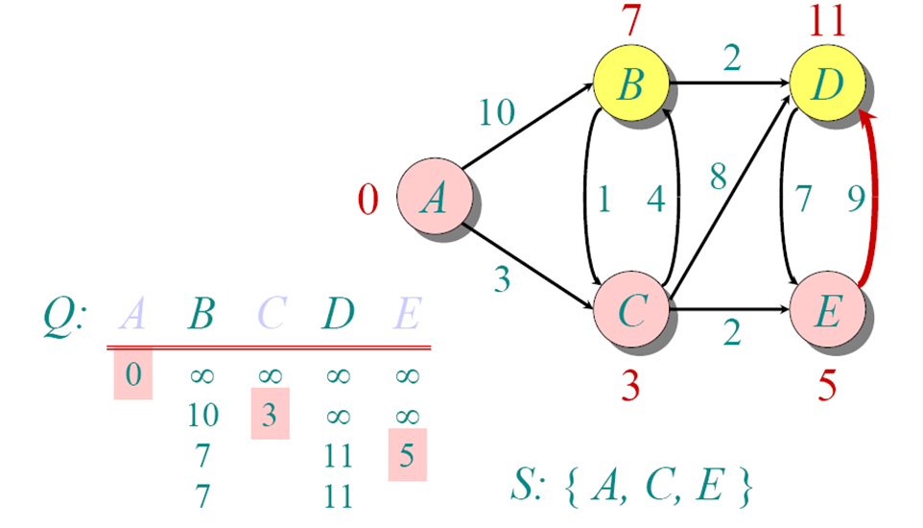
Another Example

Slide 53
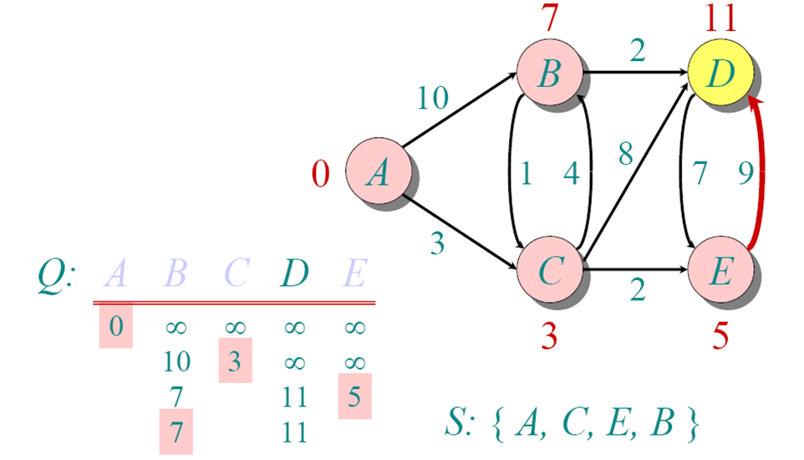
Another Example

Slide 54
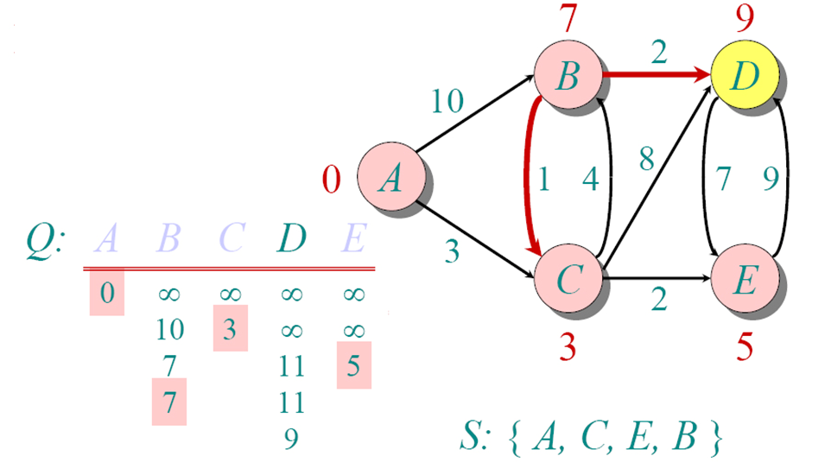
Another Example

Slide 55
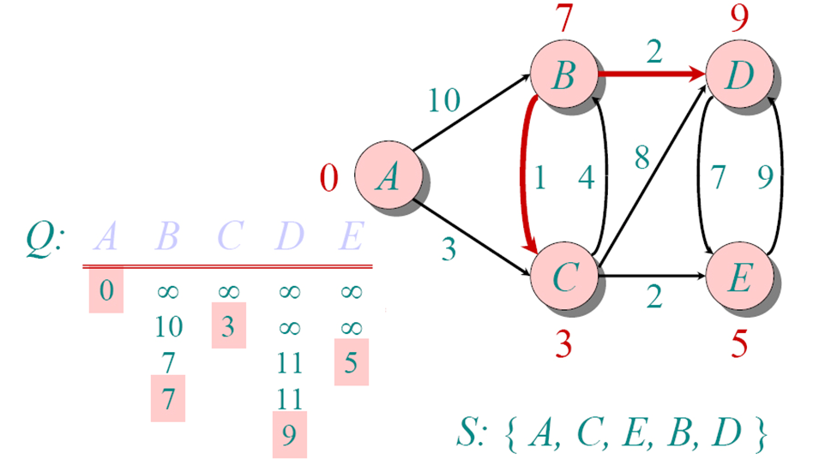
Another Example

Slide 56
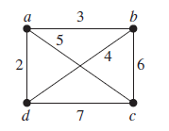
Traveling Salesperson Problem
A traveling salesperson wants to visit each of n cities exactly once and return to his starting point.

Slide 57
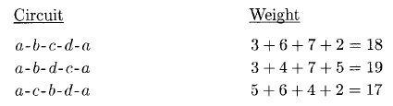
The following table shows the three different Hamilton circuits and their weights:
Thus we see that the circuit a-c-b-d-a (or the same circuit starting at some other point but traversing the vertices in the same or exactly opposite order) is the one with minimum total weight.

Slide 58
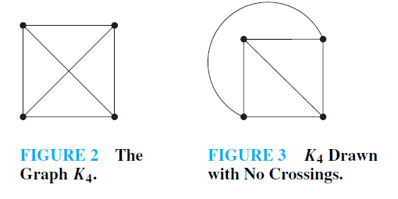
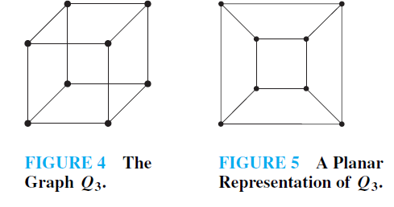
Planar Graph
A graph is called planar if it can be drawn in the plane without any edges crossing, Such a drawing is called a planar representation of the graph.

Slide 59
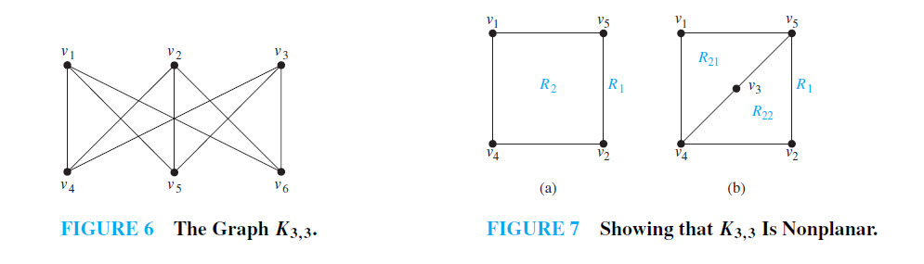
Is this a planar graph
note that there is no way to place the final vertex v6 without forcing a crossing.
Application of Planarity of graphs plays an important role in the design of electronic circuits

Slide 60
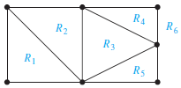
Euler’s Theorem
Let G be a connected planar simple graph with e edges and v vertices. Let r be the number of regions in a planar representation of G.
Then r = e − v + 2.
Proof:

Slide 61

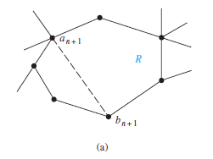
The relationship r1 = e1 − v1 + 2 is true for G1, because e1 = 1, v1 = 2, and r1 = 1
Now assume that rk = ek − vk + 2. Let {ak+1, bk+1} be the edge that is added to Gk to obtain Gk+1.
In the first case, both ak+1 and bk+1 are already in Gk. These two vertices must be on the boundary of a common region R, or else it would be impossible to add the edge {ak+1, bk+1} to Gk without two edges crossing (and Gk+1 is planar).
The addition of this new edge splits R into two regions. Consequently, in this case, rk+1 = rk + 1, ek+1 = ek + 1, and vk+1 = vk. Thus, each side of the formula relating the number of regions, edges, and vertices increases by exactly one, so this formula is still true.
In other words, rk+1 = ek+1 − vk+1 + 2.

Slide 62

In the second case, one of the two vertices of the new edge is not already in Gk.
Suppose that ak+1 is in Gk but that bk+1 is not. Adding this new edge does not produce any new regions, because bk+1 must be in a region that has ak+1 on its boundary. Consequently, rk+1 = rk.
Moreover, ek+1 = ek + 1 and vk+1 = vk + 1. Each side of the formula relating the number of regions, edges, and vertices remains the same, so the formula is still true. In other words,
rk+1 = ek+1 − vk+1 + 2.

Slide 63
Corollary
If G is a connected planar simple graph with e edges and v vertices, where v ≥ 3, then e ≤ 3v − 6.
Ex. The graph K5 has five vertices and 10 edges. However, the inequality e ≤ 3v − 6 is not satisfied for this graph because e = 10 and 3v − 6 = 9. Therefore, K5 is not planar.
If G is a connected planar simple graph, then G has a vertex of degree not exceeding five.
If a connected planar simple graph has e edges and v vertices with v ≥ 3 and no circuits of length three, then e ≤ 2v − 4.
Ex. K3,3 has no circuits of length three (this is easy to see because it is bipartite), Corollary 3 can be used. K3,3 has six vertices and nine edges. Because e = 9 and 2v − 4 = 8, Corollary 3 shows that K3,3 is nonplanar.

Slide 64


Homomorphic Graph
Two graphs G and H are said to be homomorphic if one can be obtained from other by merging of edges or addition of vertices.

Slide 65
Kuratowski’s Theorem
A graph is nonplanar if and only if it contains a subgraph homeomorphic to K3,3 or K5.
It is clear that a graph containing a subgraph homeomorphic toK3,3 orK5 is nonplanar. However, the proof of the converse, namely that every nonplanar graph contains a subgraph homeomorphic to K3,3 or K5, is complicated and will not be given here.

Slide 66

The subgraph H of the Petersen graph obtained by deleting b and the three edges that have b as an endpoint, is homeomorphic to K3,3, with vertex sets {f, d, j} and {e, i, h}, because it can be obtained by a sequence of elementary subdivisions, deleting {d, h} and adding {c, h} and {c, d}, deleting {e, f } and adding {a, e} and {a, f }, and deleting {i, j } and adding {g, i} and {g, j}.
Hence, the Petersen graph is not planar.

Slide 67
Graph Coloring
A coloring of a simple graph is the assignment of a color to each vertex of the graph so that no two adjacent vertices are assigned the same color.
The chromatic number of a graph is the least number of colors needed for a coloring of this graph. The chromatic number of a graph G is denoted by χ(G).

Slide 68


THE FOUR COLORTHEOREM The chromatic number of a planar graph is no greater than four.

Slide 69

What is the chromatic number of Kn?
chromatic number of Kn is n. That is, χ(Kn) = n. (Recall that Kn is not planar when n ≥ 5, so this result does not contradict the four color theorem.) A coloring of K5 using five colors
What is the chromatic number of the complete bipartite graph Km,n, where m and n are positive integers?
χ(Km,n) = 2. This means that we can color the set of m vertices with one color and the set of n vertices with a second color.
Because edges connect only a vertex from the set of m vertices and a vertex from the set of n vertices, no two adjacent vertices have the same color. A coloring of K3,4 with two colors

Slide 70


What is the chromatic number of the graph Cn, where n ≥ 3?
In general, two colors are needed to color Cn when n is even.
n is odd and n > 1, the chromatic number of Cn is 3.
χ(Cn) = 2 if n is an even positive integer with n ≥ 4 and
χ(Cn) = 3 if n is an odd positive integer with n ≥ 3.
Application of graph coloring can be scheduling of exams so that no students will have two exams on same day.

